Slide 1
LEI
SMPG
Paul Janssens – LEI Programme Director
April 2015

Slide 2
LEI – ISO 17442
Core LEI Record Attributes – Public database
Record creation date
Last update date
Record maintenance state
Expiry date of the record (when applicable)
Entity Status (active, dissolved, etc.)
LEI code
Registered name (Exact official name - Transliteration)
Registered address / Country
Headquarters address
Local Business Registry identification
Additional Record Attributes
Legal form
Ultimate parent LEI (hierarchy)
Immediate parent LEI (hierarchy)

Slide 3
LEI Format
LEI = 18!an 2!n
Example
HB7FFAZI0OMZ8PP8OE26
Society for Worldwide Interbank Financial Telecommunication SCRL/CVBA
Avenue Adèle 1 1310 – La Hulpe BELGIUM
Check Mod 97
Code

Slide 4
Global LEI System
Regulatory Oversight Committee
LEI Issuer
LEI Issuer
LEI Issuer
Global LEI Foundation
Industry / Public / Regulators / Vendors

Slide 5
Regulatory drivers
Dodd-Frank – CFTC
Reporting of swap transactions (OTC derivatives)
EMIR – ESMA
Reporting of derivatives (OTC and on-exchange)
Financial and non-financial counterparties
Money Market Fund Reform Rules – SEC
Money Market Statistical Reporting – ECB
MiFID II / MIFIR – ESMA
Solvency II – EIOPA
Securities and Futures (Amendment) Act – MASingapore
…….

Slide 6
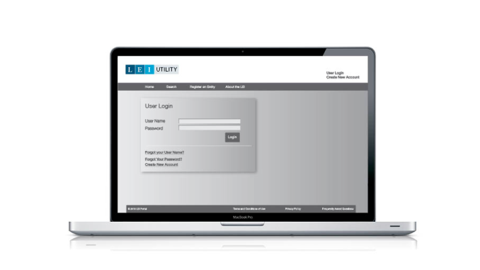
Statistics (27 Mar)
GMEI Utility
Total records 167,572
US 81,688 49%
EU 47,164 28%
All Endorsed LOUs
Total records 345,590
GMEI Utility 49.1%
Registration status
Lapsed 59,801 17% ☹

Slide 7
Action points
Registration
Ownership and Responsibility
Centralised
Decentralised
Bulk process
Renew LEIs = yearly process
Consolidated LEI file
Integration
Mapping
Reporting Requirements

Slide 8
Implementing LEI Creating a coherent picture of clients
Market participant registers
Provider assigns LEI “key”
Provider makes data set public = LEI with core data
Market participant introduces data set in data systems
LEI data set is used to identify counterparties

Slide 9
Reference data
Instruments
Market data
Counterparty
Transactions
Reporting
LEI

Slide 10
LEI in Message Standards
Long term view = global LEI adoption
Need future proof solution
Timeline
Requirements = party fields
Holistic and consistent approach
Phased introduction
Stakeholders

Slide 11
LEI Adoption ISITC September 2014 Industry Forum & Working Groups
Trade Initiation/Confirmation Process –impacts to the pre-trade, trade and post trade messaging (TIC, FpL message suites, proprietary XML vendor formats)
Listed Derivatives and FX Forwards and NDFs instruction from Inv. Manager to delegated trade repository reporting party messaging for EMIR reporting (MT/54x/304, MX, others)
LEI of UTI institution issuer
LEI of Clearing Venue
LEI of Clearinghouse clearing member
LEI of Execution Venue
OTC derivatives – trade repository reporting and delegated party instruction messaging (FpML)
Repos and Cash reporting, segregation and clearing mandate in Canada
LEI of Global Clearing Member (GCM ID)
Cash Instruction Ordering Institution identification field 52D usage (MT202 and MX)
Segregated collateral Instruction secured party/broker identification (MT54x/54y/202/210/527/558 and MX)
Tri Party Agents collateral reporting to regulators (MT535/569, MX, others)
Private Funds LEI usage for US Insurance regulatory reporting
Resolution/Living Will regulatory reporting
Security identification through LEI usage to address multi listed securities to be considered

Slide 12
Alternatives
With BIC or instead of BIC
Syntax validation, data validation, no validation?
Formats
ALTE codeword
new format type
Start with ‘optional’ field and evolve into ‘mandatory’ field
Market practices

Slide 13
LEI Implementation – Option 1
Combination of format P or Q or R with S and ALTE with LEI
Example: MT543 – field 95a
:16R:SETPRTY
:95P::BUYR/TESTUSVT
:95S::ALTE//LEIC/XX/HB7FFAZI0OMZ8PP8OE26
:16S:SETPRTY
Implication:
Make the qualifier ALTE repetitive
Create a new “Type Of Identification” Code “LEIC”
Country code being mandatory – Convention is to use XX when providing the LEI
Align the possibility to have an alternate identifier in message type that does not allow this today (eg MT564)

Slide 14
LEI Implementation – Option 2
New format L for LEI and mandatory combination of P (BIC) and L (LEI) or Q or R
Example: MT543 – field 95a with BIC and LEI
:16R:SETPRTY
:95P::BUYR/TESTUSVT
:95L::BUYR/HB7FFAZI0OMZ8PP8OE26
:16S:SETPRTY
Implication:
Create new format L
Make each qualifier repetitive in sequence SETT
Create a cross element rule that mandates presence of the format L with any other possible format that exists today (P or Q or R)
Align in message type that does not allow this today (eg MT564)
Usage of ALTE still possible in this scenario

Slide 15
LEI Implementation – Option 3
New format L for LEI optional or P or Q or R
Example: MT543 – field 95a with BIC and LEI
:16R:SETPRTY
:95P::BUYR/TESTUSVT
:95L::BUYR/HB7FFAZI0OMZ8PP8OE26
:16S:SETPRTY
Implication:
Create new format L
Make each qualifier repetitive in sequence SETT
Create a cross element rule that mandates presence of the format L with any other possible format that exists today (P or Q or R)
Align in message type that does not allow this today (eg MT564)
Usage of ALTE still possible in this scenario

Slide 16
LEI Implementation – Option 4
New format L for LEI optional or P or Q or R
Example: MT543 – field 95a with LEI only
:16R:SETPRTY
:95L::BUYR/HB7FFAZI0OMZ8PP8OE26
:16S:SETPRTY
Implication:
Create new format L
Align in message type that does not allow this today (eg MT564)
Usage of ALTE still possible in this scenario

Slide 17
Useful links
www.swift.com/lei
www.gmeiutility.org
www.leiroc.org
swiftref.swift.com/bic-lei-directory
www.gleif.org

Slide 18
tatan
grazzi
efcharisto
dekuji
paldies
havala
Thank You
obrigada
spasibo
dakujem
kiitos
obrigado
grazie
blagodarya
tack
Merci
dzieki
dekui gracias
koszi
Dank u
multumesc
Danke

