Slide 1
MyStandards
New items: new GUI, sharing & communities, base message comparison
SMPG IF, Copenhagen, 22 – 25 October 2013

Slide 2
MyStandards
New interface – more intuitive and takes into account feedback from users
New paradigm for sharing collections - ‘managed communities’
Base message comparison – easier to read!

Slide 3
MyStandards – new interface
Home pages – a direct entry point for all licensed customers.
SMPG IF has a home page. On the home page are three tabs:
We don’t have anything posted yet
News
Usage Guidelines
Communities
One place from where SMPG IF usage guidelines can be accessed
We will look at this later

Slide 4
MyStandards – new interface
A place to search for usage guidelines.
As normal, you can see all the public, the private or restricted in your group (eg, SMPG IF).
Better visibility: if a guideline (non-public) is part of a community (non-private), you can see it exists and therefore request access to it.
Using T2S as search example:
Although T2S guideline is restricted it is in an open community, so you can request T2S to give you access.

Slide 5
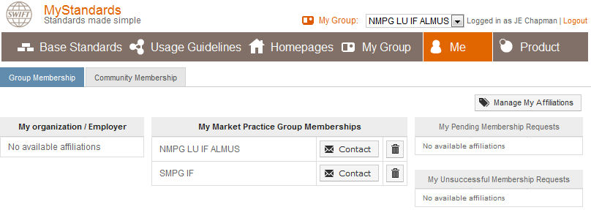
MyStandards – new interface
‘Me’ – it’s quite intuitive
Tells you which groups you are in.
This is where you would request membership to a group.

Slide 6
MyStandards – new interface
MyGroup - the private workspace of ‘your organisation’ - that is, your NMPG group or SMPG IF’ or other group of which you are a member, depending on which one you access in the ‘your group’ box:
Logged in as Charles Boniver
When you access My Group, you see all collections posted by your group.

Slide 7
MyStandards – sharing collections
In the past, when we uploaded a collection, we assigned the status Public or Private. Sometimes we set the status to restricted, and shared the collection with another group.
We did this kind of thing, to, for example, share the Orders MP in SMPG IF with NMPG LU Almus when Charles needed to run comparisons between SMPG IF and LU.
It doesn’t work like this any more!
It’s now community based.
However, the way the restricted functionality worked meant that it was not possible to ‘discover’ restricted content and there is new functionality to make this more transparent whilst still retaining control over who sees your content.

Slide 8
MyStandards – sharing collections
The easiest way to share a collection with a community is to make the collection public.
However, this may not be desirable.
To share a collection in a restricted
and controlled way involves two steps:
1. Create the community to which the collection may be shared.
This is functionality only available to the publisher role
2. Designate the collection as shared with this community.

Slide 9
1. Create a community
Example: I wanted to share the SMPG IF Orders MP with Charles in NMPG LU IF Almus (so that Charles can run a comparison of LU order MP against SMPG IF order MP).
So from ‘within SMPG IF’,
I create a community:
MyGroup → Publishing → Communities → Add Community

Slide 10
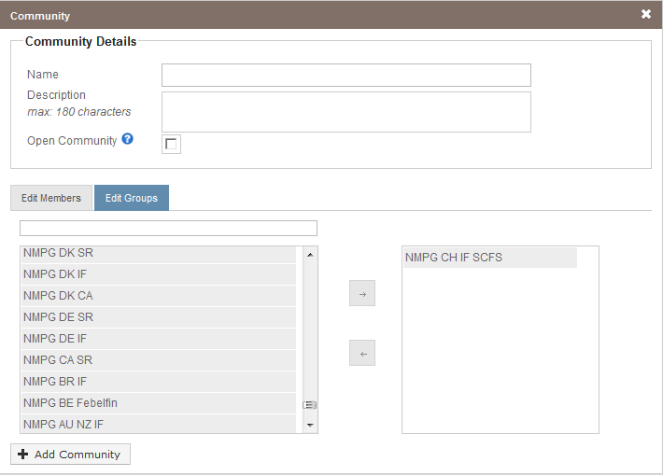
1. Create a community
SMPG IF- NMPG COMMUNE
Give the community a name and description
This community is for sharing SMPG IF collections with NMPG funds groups
Select whether the community is to open (visible but not viewable) to the outside world
Select from groups on the left and add to the box on the right
Add

Slide 11
2. Share a collection with this community
Now a publisher role of SMPG IF may share an SMPG IF collection with the ‘Funds SMPG-NMPG’ commune’:
From within ‘SMPG IF’
→ MyGroup → Publishing
Usage Guidelines TAB:
select the collection you want to share:
And then on the next screen, ‘Funds SMPG-NMPG’ commune’ can be selected.

Slide 12
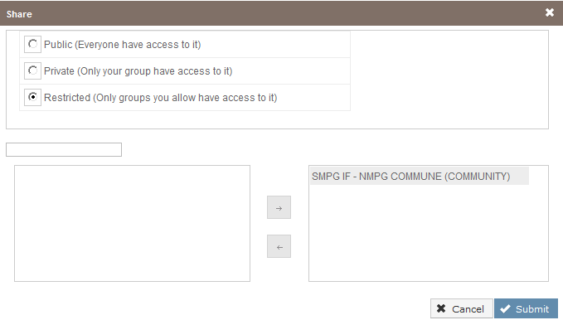
2. Share a collection with this community
Select from community on the left and add to the box on the right

Slide 13
Communities - summary
SMPG IF collection
We wanted to share an SMPG IF collection with NMPG IF LU Almus. 1. An SMPG IF publisher created a community that includes NMPG LU IF Almus, called SMPG IF- NMPG COMMUNE.
2. The collection was then designated as shared to SMPG IF- NMPG COMMUNE.
COMMUNE
NMPG LU IF Almus

Slide 14
Case Study 1
Charles (publisher Findel LU IF) wants to compare a Findel MP with AFAC. He
requests AFAC publisher to share. (CB is member of AFAC but not publisher.)
AFAC collection
[1] An AFAC publisher, from ‘within AFAC’
creates a community that includes Findel LU IF + NMPG LU IF Almus, called AFAC FUNDS COMMUNE.
[2] The AFAC collection is then designated as shared to AFAC FUNDS COMMUNE.
COMMUNE
Findel LU IF
NMPG LU IF Almus
Charles, from ‘within’ the Findel group, now may compare his Findel usage guideline with the AFAC usage guideline.

Slide 15
Case Study 2
Andrea (publisher NMPG IT IF) wants to compare an IT MP with Findel. He
requests Findel publisher to share.
Findel LU IF collection
[1] A Findel publisher, from ‘within Findel’
creates a community that includes NMPG IT IF, called FINDEL FUNDS COMMUNE.
[2] The Findel collection is then designated as shared to FINDEL FUNDS COMMUNE.
COMMUNE
NMPG IT IF
Andrea, from ‘within’ the NMPG IT IF group, now may compare his IT usage guideline with the Findel usage guideline.

Slide 16
View what’s inside a community
To view who is in community
From within the group in which you have created the community, for example, ‘SMPG IF’
MyGroup → Publishing
Communities TAB: select the community
Click here for the members
The collections shared to the community.

Slide 17
MyStandards
New interface – more intuitive and takes into account feedback from users
New paradigm for sharing collections - ‘managed communities’
Base message comparison – easier to read!

Slide 18
Publishers & Administrators
To upload collections go to
→ MyGroup → Publishing:
To add members, assign permissions: → MyGroup → Administration

Slide 19
Publishers
To download a Usage Guideline Editor, MT & MX repository, UG Editor User Guide and Best Practices:
→ MyGroup → Publishing → Usage Guideline Editor

Slide 20
Base Message Comparison
This is new and improved!
Comparison of base messages is available to the publisher role
There are two views
[1] show only changes (default view) – the differences are only shown at ‘high-level’. For example, if a new element is added, you see the data type but not the content of the data type.
[2] show the whole message (de-select ‘show only changes’).
This gives the full view of the message and the differences.

Slide 21
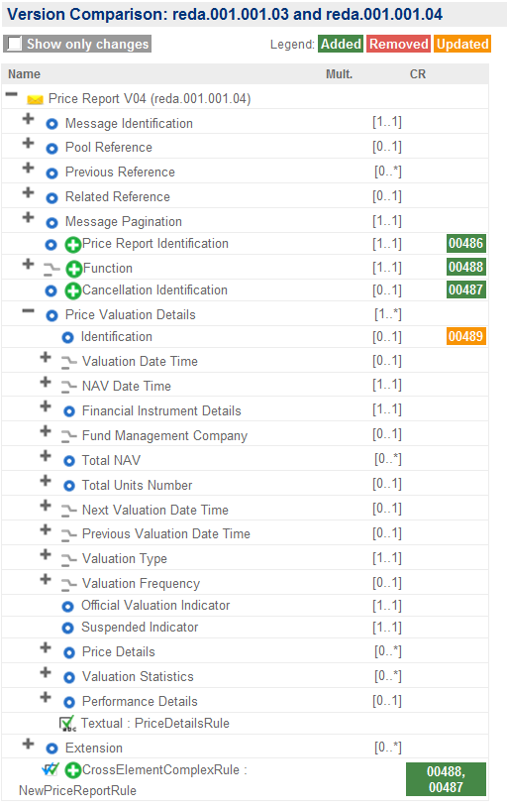
Base Message Comparison
Colour convention & text indicates the kind of change (in the past symbols such as
were used, and although there was a legend we still had difficulties to understand!
We added these three elements
We amended this by changing the multiplicity
Visually, the concept is, this is the message and this is the stuff that is different.

Slide 22
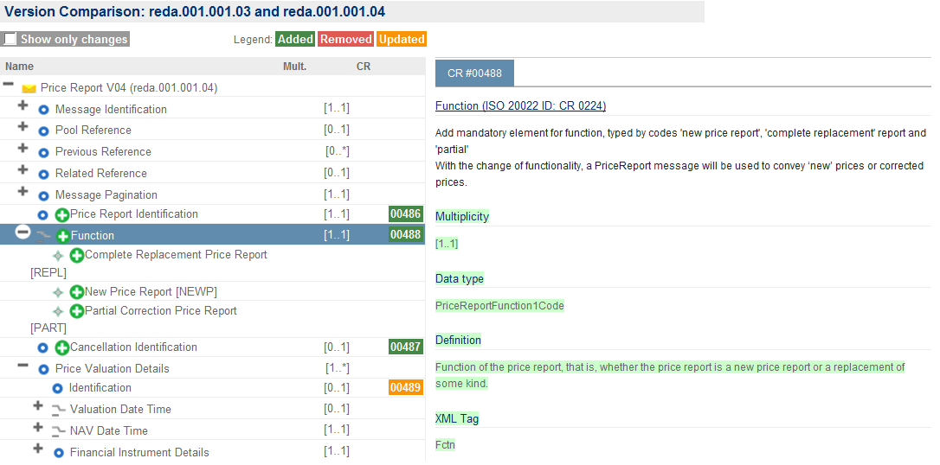
Base Message Comparison
If CR number is clicked, the CR (high-level) appears on the right hand side

Slide 23
SMPG – IF NMPG Groups
NMPG IF AU & NZ
NMPG IF BR
NMPG IF CH SCFS
NMPG IF DE
NMPG IF DK
NMPG IF FR
NMPG IF GB
NMPG IF IT
NMPG IF LU ALMUS
NMPG IF NO
NMPG IF SE
Findel LU IF
AFAC
11 Funds NMPGs

Slide 24
SMPG – IF NMPG Groups Activity
 | Not public | Public
SMPG IF | 6 | -
NMPG IF AU & NZ | 2
NMPG IF BR | 1
NMPG IF CH SCFS | 3
NMPG IF DK | - | -
NMPG IF FR |  | 1
NMPG IF GB | 6 | 2
NMPG IF IT |  | 5
NMPG IF LU ALMUS | 3
NMPG IF NO | 2
NMPG IF SE | 1 | 1
Findel LU IF | 6
AFAC | 3
Base Message Comparison

Slide 25
Managed Communities – the concept
Usage Guidelines
Restricted
Access managed by publisher role
Shared with
‘Discoverable’ and access can be requested
Managed Community

