Slide 1
Updating order process market practice for ISO 20022 MX release 2017
Inclusion of hedge/alternative funds MP
Last updated 21 April 2017

Slide 2
Topics
[1] Background to alternative / hedge funds
[2] Differences between ‘classic’ and alternative/hedge
[3] General principals for the incorporation of alternative hedge market practice into the usage guidelines of the ‘classic’ fund.
[4] How might this look? – a ‘trial’ has been done for the subscription order (setr.010) and the subscription order confirmation (setr.012)

Slide 3
Hedge Funds – Background (1 of 4)
2008 SWIFT developed hedge funds messages. A market practice was developed for these SWIFT messages, called ‘SHARP’.
2014 The Swiss community (SCFS) submitted a CR to ISO for addition of hedge funds functionality to ‘mutual funds messages’
2015 SWIFT was requested to get the hedge funds messages ISO approved and SWIFT began the submission work.
In the meantime, a market practice, called GAIA, had been developed for the use of the ISO 20022 mutual funds order messages for hedge/alternative funds. This market practice:
was well received
covers 80% of hedge/alternative funds scenarios.
but in some cases, the market practices specifies a work-around – the standard (V03) as it exists does not quite support alternative/hedge funds

Slide 4
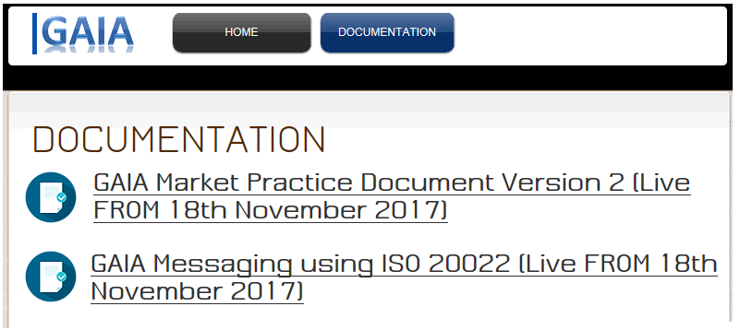
Hedge Funds – Background (2 of 4)
GAIA Global Alternative Investment Automation www.gaiastandard.org
Date dictionary: standard process definitions and
a set of messaging scenarios for order processing and reporting functions.
Mapping from GAIA data dictionary to ISO 20022 funds order messages
Originally produced for V03 of the funds MX, already updated for V04

Slide 5
Hedge Funds – Background (3 of 4)
2016 Swiss CR for addition of hedge funds functionality to ‘mutual funds messages’ (CR 0454):
Agreed by SMPG funds. Approved by ISO.
Subsequently the ‘Funds Evaluation Team’ (a subgroup of the ISO 20022 Standards Evaluation Group (SEG) ” agreed that the GAIA specification should be used as the basis of how the mutual funds messages are to be updated for hedge/alternative funds functionality in support of CR 0454.
SWIFT withdrew the submission for its hedge funds messages from ISO. ^{*1}
The 2017 Funds MXs contain the agreed functionality for alternative/ hedge funds
(^{*1} The SWIFT hedge funds messages will remain on the SWIFT network until no longer used.)

Slide 6
Hedge Funds – Background (4 of 4)
2016 In the SMPG Zurich meeting Sept 2016 it was agreed that SMPG IF should publish market practice for hedge funds
GAIA agreed we could plagiarise the GAIA work in the production of the SMPG market practice,
SMPG agreed the GAIA work should be acknowledged and reference the GAIA documentation (we don’t want to reinvent the wheel)
Next steps: work out how we will incorporate the GAIA market practices in the SMPG ‘classic’ order market practice

Slide 7
Differences between market practice for ‘classic’ and alternative/hedge for the subscription order setr.010.001.04

Slide 8
Differences between ‘classic’ and hedge – setr.010 (1 of 5)
[1.1] Message Identification
[0.1] Pool Reference
[0.1] Previous Reference
[1.1] Multiple Order Details
[0.1] Master Reference
[0.1] Place Of Trade
[0.1] Order Date Time
[0.1] Expiry Date Time
[0.1] Requested Future Trade Date
[0.1] Cancellation Right
[1.1] Investment Account Details
[0.n] Beneficiary Details
[1.n] Individual Order Details [1.1]
[0.1] Bulk Cash Settlement Details
[0.1] Total Settlement Amount
[0.1] Copy Details
[0.n] Extension
Classic: allowed. Hedge ‘do not use’
Classic: ‘do not use. Hedge ‘allowed’
See next slide
= ‘do not use’. If an xsd schema of the usage guideline is generated via MyStandards, this element would not be in the xsd schema

Slide 9
Differences between ‘classic’ and hedge – setr.010 (2 of 5)
Investment Account Details
[1.1] Account Identification
[0.1] Account Name
[0.1] Account Designation
[0.n] Owner Identification
[0.1] Account Servicer
[0.1] Order Originator
[0.1] Sub Account Details
Classic: allowed. Hedge mandatory.
Classic: allowed. Hedge not allowed

Slide 10
Differences between ‘classic’ and hedge – setr.010 (3 of 5)
Individual Order Details (1 of 2)
[1.1] Order Reference
[0.1] Client Reference
[0.10] Order Type
[1.1] Financial Instrument Details
[0.1] Sub Account For Holding
[1.1] Amount Or Units (choice)
[1.1] Units Number
[1.1] Gross Amount
[1.1] Net Amount
[0.1] Rounding
[0.1] Settlement Amount
[0.1] Cash Settlement Date
[0.1] Settlement Method
[0.1] Foreign Exchange Details
[0.1] Income Preference
[0.1] Letter Intent Reference
[0.1] Accumulation Right Reference
[0.1] Transaction Overhead
Classic: allowed. Hedge not allowed.
Classic: not allowed. Hedge not allowed.
Classic: allowed. Hedge not allowed.

Slide 11
Differences between ‘classic’ and hedge – setr.010 (4 of 5)
Individual Order Details continued (2 of 2)
[0.1] Settlement And Custody Details
[1.1] Physical Delivery Indicator
[0.1] Physical Delivery Details
[0.1] Requested Settlement Currency
[0.1] Requested NAV currency
[0.1] Cash Settlement Details
[0.1] Non Standard Settlement Information
[0.1] Staff Client Breakdown
[0.1] Financial Advice
[0.1] Negotiated Trade
[0.n] Related Party Details
[0.1] Equalisation
[0.n] Source of Cash
[0.1] Customer Conduct Classification
[0.1] Transaction Channel Type
[0.1] Signature Type
[0.1] Order Waiver Details
Classic: allowed. Hedge not allowed.
Classic: allowed. Hedge not allowed.
Classic: allowed. Hedge not allowed.
Classic: allowed. Hedge not allowed.
Classic: allowed. Hedge not allowed.
Classic: not allowed. Hedge allowed.

Slide 12
Differences between ‘classic’ and hedge – setr.010 (5 of 5)
Financial Instrument Details
[1.1] Identification CHOICE
ISIN
SEDOL
etc
Other Proprietary Identification
[0.1] Name
[0.1] Short Name
[0.1] Supplementary Identification
[0.1] Class Type
[0.1] Securities Form
[0.1] Distribution Policy
[0.1] Product Group
[0.1] Series Identification
Classic: not allowed. Hedge allowed.
Classic: not allowed. Hedge allowed.
Classic: not allowed. Hedge allowed.
Classic: not allowed. Hedge not allowed (not allowed in subscription).

Slide 13
Differences between market practice for ‘classic’ and alternative/hedge for the subscription order confirmation setr.012.001.04

Slide 14
Differences between ‘classic’ and hedge – setr.012 (1 of 6)
[1.1] Message Identification
[0.1] Pool Reference
[0.n] Previous Reference
[0.1] Related Reference
[1.1] Multiple Order Details
[0.1] Amendment Indicator
[0.1] Master Reference
[0.1] Place Of Trade
[0.1] Order Date Time
[0.1] Received Date Time
[0.1] Requested Future Trade Date
[0.1] Cancellation Right
[1.1] Investment Account Details
[0.n] Beneficiary Details
[1.n] Individual Execution Details [1.1]
[0.1] Total Settlement Amount
[0.1] Bulk Cash Settlement Details
[0.1] Copy Details
[0.n] Extension
Classic: allowed. Hedge ‘do not use’.
Classic: allowed. Hedge ‘do not use’.
Classic: allowed. Hedge ‘do not use’.
= ‘do not use’. If an xsd
schema of the usage guideline is generated via MyStandards, this element would not be in the xsd schema

Slide 15
Differences between ‘classic’ and hedge – setr.012 (2 of 6)
Investment Account Details
[1.1] Account Identification
[0.1] Account Name
[0.1] Account Designation
[0.n] Owner Identification
[0.1] Account Servicer
[0.1] Order Originator
[0.1] Sub Account Details
Classic: allowed. Hedge not allowed.

Slide 16
Differences between ‘classic’ and hedge – setr.012 (3 of 6)
Individual Execution Details
[1.1] Order Reference
[1.1] Deal Reference
[0.1] Client Reference
[0.10] Order Type
[1.1] Financial Instrument Details
[0.1] Sub Account For Holding
[1.1] Units Number
[0.1] Net Amount
[0.1] Gross Amount
[1.1] Trade Date Time
[1.1] Dealing Price Details
[0.2] Informative Price Details
[1.1] Settlement Amount
0.1] Cash Settlement Date
[0.1] Settlement Method
[1.1] Partially Executed Indicator
[0.1] Best Execution
[1.1] Cum Dividend Indicator
Classic: allowed. Hedge not allowed.
Classic: optional. Hedge mandatory.
Classic: allowed. Hedge not allowed.

Slide 17
Differences between ‘classic’ and hedge – setr.012 (4 of 6)
Individual Execution Details continued
[0.1] Interim Profit Amount
[0.n] Foreign Exchange Details
[0.1] Income Preference
[0.1] Letter Intent Reference
[0.1] Accumulation Right Reference
[0.1] Transaction Overhead
[0.1] Informative Tax Details
[0.1] Settlement And Custody Details
[1.1] Physical Delivery Indicator
[0.1] Physical Delivery Details
[0.1] Requested Settlement Currency
[0.1] Requested NAV Currency
[0.1] Refund
[0.1] Subscription Interest
[0.1] Cash Settlement Details
[0.1] Non Standard Settlement Information
[0.1] Partial Settlement of Units
[0.1] Partial Settlement of Cash
Classic: allowed. Hedge not allowed.
Classic: allowed. Hedge not allowed.

Slide 18
Differences between ‘classic’ and hedge – setr.012 (5 of 6)
Individual Execution Details continued
[0.4] Staff Client Breakdown
[0.1] Financial Advice
[0.1] Negotiated Trade
[0.1] Late Report
[0.n] Related Party Details
[0.1] Equalisation
[0.1] Source Of Cash
[0.1] Customer Conduct Classification
[0.1] Transaction Channel Type
[0.1] Signature Type
[0.10 Order Waiver Details
Classic: allowed. Hedge not allowed.
Classic: not allowed. Hedge allowed.

Slide 19
Differences between ‘classic’ and hedge – setr.012 (6 of 6)
Financial Instrument Details
[1.1] Identification CHOICE
ISIN
SEDOL
etc
Other Proprietary Identification
[0.1] Name
[0.1] Short Name
[0.1] Supplementary Identification
[0.1] Class Type
[0.1] Securities Form
[0.1] Distribution Policy
[0.1] Product Group
[0.1] Series Identification
Classic: not allowed. Hedge allowed.
Classic: not allowed. Hedge allowed.
Classic: not allowed. Hedge allowed.
Classic: not allowed. Hedge allowed.
Classic: not allowed. Hedge allowed.

Slide 20
Differences between ‘classic’ and hedge – setr.012 (7 of 7)
Transaction Overhead
[0.1] Total Overhead Applied
[0.1] Total Fees
[0.1] Total Taxes
[0.1] Commercial Agreement Reference
[0.n] Individual Fee
[0.n] Individual Tax
Informative Tax Details
See next slide
Classic: allowed. Hedge not allowed.
See next slide

Slide 21
Differences between ‘classic’ and hedge – setr.012 (8 of 7)
Although SMPG designates TotalTaxes as ‘do not use’ because it makes no recommendation about tax in general, it is recommended that TotalTaxes is the sum of the AppliedAmount elements in the iterations of IndividualTax. Do not use if the currencies of the amounts in IndividualTax are not the same
SMPG ‘Classic
[0.1] Total Taxes
[0.n] Individual Tax
Each market will have to define its own use for tax and therefore SMPG does not make any recommendations.
GAIA has both Total Taxes and Individual Tax as ‘allowed’ but no specific usage on the tax type codes, but does say only Type and tax amount are to be used).
In other words, the GAIA document would have to say something “GAIA makes no recommendations about the inclusion of tax”.)

Slide 22
Differences between ‘classic’ and hedge – setr.012 (9 of 7)
Individual Fee
[1.1] Type
[0.1] Basis
[0.1] Standard Amount
[0.1] Standard Rate
[0.1] Discount Details
[0.1] Applied Amount
[0.1] Applied Rate
[0.1] Non Standard SLA Reference
[0.1] Recipient Identification
[1.1] Informative Indicator
Classic: allowed. Hedge not allowed.
Classic: allowed. Hedge not allowed.
Classic: allowed. Hedge not allowed.
Classic: allowed. Hedge not allowed.

Slide 23
Differences between ‘classic’ and hedge – setr.012 (10 of 7)
Type
Additional Fee ADDF
Back End Load BEND
Brokerage Fee BRKF
Commission COMM
Commission De Placement CDPL
Contingent Deferred Sales Charge CDSC
Correspondent Bank Charge CBCH
Dilution Levy DLEV
Front End Load FEND
Initial Charge INIT
Postage POST
Premium PREM
Service Provision Fee CHAR
Shipping SHIP
Switch SWIT
UCITS Commission UCIC
Regulatory Fee REGF
Penalty PENA
Classic: allowed. Hedge not allowed.
Classic: allowed. Hedge not allowed.
Classic: allowed. Hedge not allowed.

Slide 24
Incorporating hedge MP into ‘classic’
APPROACH 1
Incorporate hedge usage into ‘classic’ message usage guideline
An element that is currently ‘do not use’ would have to be set to ‘allowed’ and usage information added, for example:
“If the financial instrument is an alternative/hedge fund, then Requested Future Trade Date is allowed. If the financial instrument is a 'classic' fund, then Requested Future Trade Date is NOT allowed.”
DISADVANTAGE
Previously an element is ‘do not use’ – now, it’s allowed and you have to read the usage information in order to know if the element is allowed or not. This is a dilution of the ‘formalism’ we previously had.

Slide 25
Incorporating hedge MP into ‘classic’
APPROACH 1
Incorporate hedge usage into ‘classic’ message usage guideline
For hedge funds usage there are lots of elements that are
‘do not use’ . Now many elements would have to be ‘allowed’ to cater for the ‘classic’ funds usage. For example:
“If the financial instrument is an alternative/hedge fund, then Order Date Time is NOT allowed.”
DISADVANTAGE
The hedge funds is a slim and easy market practice. But there will be many elements that are allowed and for each one you have to read the usage guideline in order to know if the element is allowed or not.
This approach means we would lose much of the ‘formalism’ that should be possible.

Slide 26
Incorporating hedge MP into ‘classic’
APPROACH 1
Incorporate hedge usage into ‘classic’ message usage guideline
In addition, we will need an explanatory note, something along the lines of:
If usage information is not preceded by:
"if the financial instrument is an alternative/hedge fund"
or
"if the financial instrument is a 'classic' fund"
then the usage applies to both the 'classic' funds and the alternative/hedge funds.

Slide 27
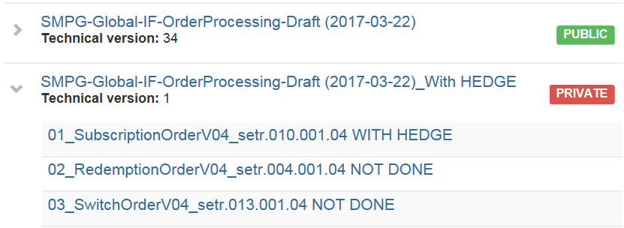
Incorporating hedge MP into ‘classic’
APPROACH 1
Incorporate hedge usage into ‘classic’ message usage guideline
As a trial run, one example of incorporating hedge into classic has been done, this has been done on MyStandards for setr.010 & setr.012

Slide 28
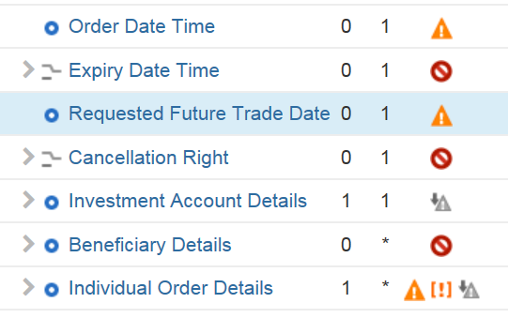
APPROACH 1: What does it look like? (1 of 2)
Requested Future Trade Date
Rule “SMPG Routing Rule”
If the financial instrument is an alternative/hedge fund and the
trade is to be routed by the AIP service, then Requested Future
Trade Date must be present.
SMPG Usage Information
So, previously, Requested Future
Trade Date was .
In order to accommodate hedge, it
has been designated ‘allowed’ and
there is a usage annotation to
indicate it must not be used for ‘classic’.
If the financial instrument is an alternative/hedge fund, then RequestedFutureTradeDate is allowed. If the financial instrument is a 'classic' fund, then Requested FutureTradeDate is not allowed.
As said, this is a dilution of the ‘formalism’ we previously had.

Slide 29
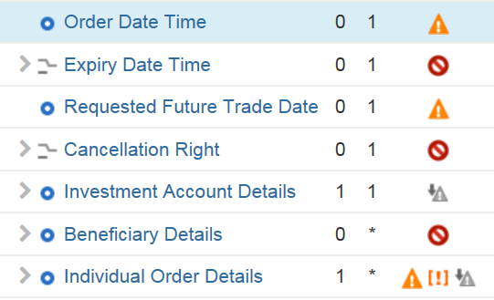
APPROACH 1: What does it look like? (2 of 2)
Order Date Time
SMPG Usage Information
If the financial instrument is an alternative/hedge fund, then
OrderDateTime is not allowed.
If the financial instrument is a 'classic' fund, then OrderDateTime may be present.
Order Date Time is allowed in the ‘classic’, but not for hedge.
So Order Date Time remains as ‘allowed’ and a usage annotation is added to indicate it must not be used for hedge.
If hedge was a separate usage guideline, Order Date Time could be ‘do not use’ .
In a similar way, we see a dilution of potential formalism.

Slide 30
Incorporating hedge MP into ‘classic’
APPROACH 2
Have the same collection for both ‘classic’ and ‘hedge’, but have individual guidelines for each – see next slide

Slide 31
Incorporating hedge MP into ‘classic’
SMPG-IFWG-MP-OrdersProcessing-Draft-2017-03-22) With HEDGE APPROACH 2
Documents
GAIA Market Practice Document Version 2 Live 18 Nov 2017.pdf
GAIA documents also to be posted with the collection
GAIA Messaging using ISO 20022 Live 18 Nov 2017.pdf
SMPG-IFWG-MP-OrdersProcessing-Draft_SR2017_2017-03-22.docx
Description
MARKET PRACTICE - VERSION 4.0 (for SR2017)
The message usage guidelines published in this collection should be read in conjunction with ‘SMPG-IFWG-MP-OrdersProcessing-Draft_SR2017_2017-03-16’ and "GAIA".
Usage Guidelines
01_SubscriptionOrderV04_setr.010.001.04 - mutual
02_SubscriptionOrderV04_setr.010.001.04 - alternative
03_RedemptionOrderV04_setr.004.001.04 – mutual
02_RedemptionOrderV04_setr.004.001.04 - alternative
03_SwitchOrderV04_setr.013.001.04 - mutual

Slide 32
Order Process Document
APPROACH 2
The order process document, section 7 should be updated. Section 7 is where we identify the message guideline names on MyStandards, for example:
Collection Name
SMPG-Global-IF-Order Processing-Final
Message Usage Guidelines
01_SubscriptionOrderV03_setr.010.001.04
02_RedemptionOrderV03_setr.004.001.04
Current
Proposal
7 Business Data Requirements
7 Business Data Requirements
7.1 ‘Classic’
7.2 Alternative/Hedge

Slide 33
Incorporating hedge MP into ‘classic’
SMPG-IFWG-MP-OrdersProcessing-Draft-2017-03-22) With HEDGE APPROACH 1
Documents
GAIA Market Practice Document Version 2 Live 18 Nov 2017.pdf
GAIA documents also to be posted with the collection
GAIA Messaging using ISO 20022 Live 18 Nov 2017.pdf
SMPG-IFWG-MP-OrdersProcessing-Draft_SR2017_2017-03-22.docx
Description
MARKET PRACTICE - VERSION 4.0 (for SR2017)
The message usage guidelines published in this collection should be read in conjunction with ‘SMPG-IFWG-MP-OrdersProcessing-Draft_SR2017_2017-03-16’ and "GAIA". This market practice is DRAFT - IT IS A TRIAL RUN FOR INCLUDING ALTERNATIVE/HEDGE MP INTO THE SUBSCRIPTION ORDER. The expression 'classic' fund denotes a 'normal' fund such as a mutual fund.
If usage information is not preceded by "if the financial instrument is an alternative/ hedge fund" or "if the financial instrument is a 'classic' fund" then the usage applies to both the 'classic' funds and the alternative/hedge fund.
Usage Guidelines
01_SubscriptionOrderV04_setr.010.001.04 with HEDGE
02_RedemptionOrderV04_setr.004.001.04 NOT DONE
03_SwitchOrderV04_setr.013.001.04 NOT DONE

