Slide 1
Updating Account Management market practice for ISO 20022 MX release 2017
Discussion items
Last updated 19 April 2017

Slide 2
Account Management messages were maintained for SR 2017
 |  | Nov 2016 | Nov 2017
1 | Account Opening Instruction | Acmt.001.001.06 | Acmt.001.001.07
2 | Account Details Confirmation | Acmt.002.001.06 | Acmt.002.001.07
3 | Account Modification Instruction | Acmt.003.001.06 | Acmt.003.001.07
4 | Account Management Status Report | Acmt.006.001.05 | Acmt.006.001.06

Slide 3
Volumes Funds MX on SWIFT (January 2016 – end Feb 2017)
 | Messages | Volume | BICs
acmt | Account opening, confirmation, modification, status | 209,942 | 14
reda | Price report | 311,056 | 28
 | Fund Processing Passport | 0 | 0
setr | Subscription, redemption, switch, status | 91,958,035 | 385
 | Alternative/hedge funds | 76,141 | 6
semt | Securities Message Rejection | 11,231 | 8
 | Statements – holdings, transactions | 853,678 | 38
sese | Funds transfers | 1,425,709 | 18
camt | Funds cash forecast | 49,669 | 10
There are probably higher volumes of Funds account management and price report messages on other networks
Volumes are live & pilot
There are 390+ BICs using the SWIFTNet funds solution

Slide 4
Account Management messages were maintained for SR 2017
[1] The Account Management market practice process document was updated. The main change is inclusion of a new section ‘account closure’
[2] The market practice usage guidelines were migrated using the Usage Guideline Editor functionality; fixes were done where loss of usage information occurred because a ‘path’ changed as a result of the maintenance (a small impact)
[3] Review session took place - AM, SB & JEC reviewed the new elements and functionality and made decisions on whether to include in market practice or not
[4] Draft version posted on MyStandards
There is just one item for which further input is actively solicited.

Slide 5
Account Parties
[1.1] Principal Account Party (choice)
[1.1] Primary Owner
[1.5] Trustee
[1.1] Nominee
[1.5] Joint Owner
[0.n] Secondary Owner
[0.n] Beneficiary
[0.n] Power Of Attorney
[0.n] Legal Guardian
[0.1] Custodian For Minor
[0.5] Successor on Death
[0.n] Administrator
[0.n] Other Party
[0.5] Granter
[0.5] Settlor
[0.n] Senior Managing Official
[0.n] Protector
[0.1] Registered Shareholder Name
SB: allow Senior Managing Official & Protector - they are ‘global concepts’.
AM: if we base ourselves on current usage guidelines, then we should set Senior Managing Official & Protector to ‘do not use’ to be consistent.
Proposal on next slide.
Error - see later
Should these new parties be allowed or set to ‘do not use’?

Slide 6
Account Parties
[1.1] Principal Account Party (choice)
[1.1] Primary Owner
[1.5] Trustee
[1.1] Nominee
[1.5] Joint Owner
[0.n] Secondary Owner
[0.n] Beneficiary
[0.n] Power Of Attorney
[0.n] Legal Guardian
[0.1] Custodian For Minor
[0.5] Successor on Death
[0.n] Administrator
[0.n] Other Party
[0.5] Granter
[0.5] Settlor
[0.n] Senior Managing Official
[0.n] Protector
[0.1] Registered Shareholder Name
Proposal – SB: if we set parties to as shown on this slide, this would cover 85% of cases. (AM concurs)
(AM: theoretically there is no reason to exclude any of the others – all parties could be included, none of these parties are ‘local’.)
Added in SR 2016 for DK market

Slide 7
Separate Issue – custodian for minor - 2016
When compared to 2015, it can be seen this inconsistency was introduced in 2016 version of the MP. It probably should have been ‘do not use’ throughout.
Inconsistency of usage defined for ‘Custodian For Minor’ in the 2016 version of the MP - (issue may be resolved by slide 6 outcome)
Not allowed in acmt.001
Allowed in acmt.002
Allowed in acmt.003

Slide 8
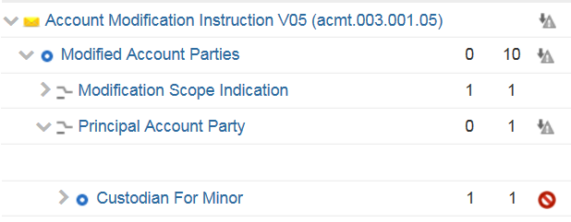
Separate Issue – custodian for minor - 2015

