Slide 1
Funds Maintenance 2017 and beyond
Updated following discussion at SMPG Investment Funds, Singapore, 7 - 9 October 2015
Last updated 5 April 2016

Slide 2
Funds messages
BA | ‘Sub-process’ | Identifier range | # | Comment
acmt | Account opening | Acmt.001-006 | 6 | Maintained for 2013, 2014, 2015, 2016
camt | Cash forecast reporting | Camt.040-045 | 6 | Maintained for 2015
reda | Price Reporting | reda.001-002 | 2 | Maintained for 2013
reda | FPP | Reda.004-005 | 2
semt | Statements of Holdings | Semt.002-005 | 4 | To be replaced by new versions produced by S & R (date to be agreed)
semt | Statement of investment fund transactions | Semt.006-007 | 2 | Maintained for 2015 (not in Funds Solution)
semt | Message rejection | Semt.001 | 1 | Maintained for 2015
sese | Transfers | Sese.001-014 & 018-019 | 16 | Maintained for 2012, 2013, 2014, 2015, 2016
setr. | Orders | Setr.001-018 & 047-058 | 32
 |  |  | 71

Slide 3
Maintenance 2016 - 2017 : non-order messages
Early indications for CRs for 2017
[1] acmt
[a] There will be legislative changes that require an update to the acmt messages (source: Italy)
[b] Maybe CRs will be received from Finland and Sweden for fine-tuning of the acmt messages for securities account functionality
[2] sese
Maybe UK will submit CRs to eliminate work-arounds for UK Single Leg Transfer process.
Will be deferred to a later maintenance
8 Oct 2015:
When the orders maintenance is done, it will include all outstanding business and technical changes for the ‘setr’ messages. The maintenance should ONLY be on the setr messages (unless legislative changes are required).
FMAG consultation Dec 2015: divided, some say (as always!) should be kept to a minimum.

Slide 4
Maintenance 2016-2017 : order messages
The maintenance freeze has been lifted. There is agreement that the first maintenance on orders should be for November 2017. It has been agreed that it should only be a maintenance on the order (setr) messages and any messages that require updates for regulatory reasons (eg, funds account management (acmt) messages).
Users of the orders messages have been holding back from submitting change requests because there is no planned maintenance date. So there isn’t a good view on the total number of changes.
An announcement has been made to SWIFT Funds users that there is to be an order maintenance for November 2017, to give plenty of advance warning and to request users to submit any change requests to ISO. THIS ANNOUNCEMENT HAS BEEN DONE (December 2015)

Slide 5
Technical Changes
These are changes that must be made for ISO 20022 compliance.
[1] Change of XOR construct to choice component
[2] BEI Elimination
[3] Replacement of obsolete components (this overlaps with item 2 and item 1)
[4] Extension replaced with Supplementary Data TBC
[5] Application Header replaced with Business Application Header (BAH). Elimination of duplicate elements TBC
[6] ISO XML 1.5
[7] Replace SWIFT URN with ISO URN (SWIFT item) for SWIFTNet Funds)

Slide 6
Alternative / Hedge Funds Impacts on Maintenance
Summary of situation
[1] Planned that the alternative hedge funds messages (setr.059 – 064) would be submitted for ISO approval in 2015.
[2] However, CR to added alternative/hedge funds functionality to the existing mutual messages (setr.001-018, 047-058) approved.
[3] A ‘hedge mutual funds task force’ held to discuss impacts.
[4] In the meantime, a market practice (GAIA) was developed for using the existing mutual messages for alternative hedge. Well received by community (does involve some work-arounds).
[5] Agreed this MP should be studied, and used as basis for enhancement of mutual messages to include alternative hedge functionality.
[6] Alternative hedge funds messages ISO submission frozen.
[7] Existing Alternative hedge funds messages in Funds solution will remain until no market demand.
[8] The elements to be added to the mutual funds messages have been identified (see document on smpg)

Slide 7
Other CRs to be submitted for order messages
NEW
From Luxembourg.
From Italy.
New CRs from SWIFT Standards on behalf of SMPG and ISO (23 CRs – many to correct usage rule errors in path descriptions).
Updated versions of CRs already submitted – an appendix has been added to give some detail or clarity and a better view of the impact (7 CRs).
See ‘ISO CRs Funds List’ xls in smpg folder ‘2016-1_Spring/Helsinki / 3_Maintenance_2017
Added 6 April 2016

Slide 8
Maintenance Item: Net Amount and Gross Amount
Summary of situation
[1] SMPG IF agreed new definitions of these elements.
[2] CR 376 for setr - update definitions (status ‘to be considered next time messages are maintained’)
[3] CR 82 for sese message – replace net and gross with ordered and executed (status of CR is withdrawn)
[4] Conclusion – no change to net and gross (except eliminate XOR and update definitions)

Slide 9
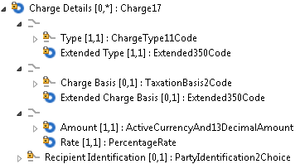
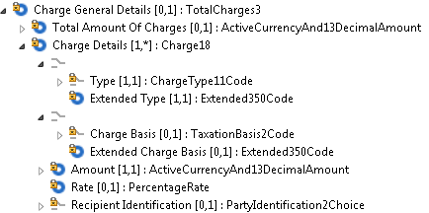
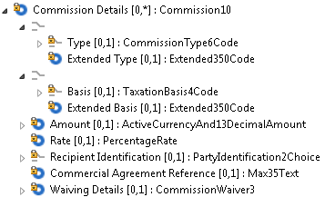
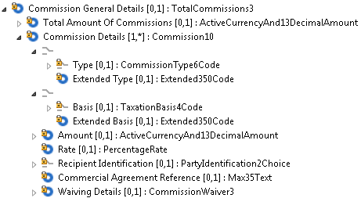
Merge Charge Details and Commission Details
NEW
Current Charges - order
Current Charges - confirmation
Total may be specified
FLAT
PERU
Amount or Rate not both
Amount is mandatory
Current Commissions - order
Current Commissions - confirmation
Total may be specified
FLAT
GRAM
NEAM
PERU
Amount and rate optional
Amount and rate optional

Slide 10
Charges and Commissions – change requests
CR nnn Luxembourg – merge charges and commissions into a single sequence
CR 107 Italy – new charge type code FX
CR 092 Italy – SLA Reference
CR 371 Italy - Separate element for Discount Rate/Amount needed (should be possible to specify a discount on a charge)
CR 372 SMPG – revise definitions of FEND, BEND, CHAR & CDSC. Delete BRKF.
CR 374 SMPG – revise definitions of FEND, BEND
CR 092 SMPG – should be possible to specify total charges/commissions without have to give breakdown (change multiplicity)
CR 353 Replace XOR with choice components

Slide 11
The merged sequences
NEW
Order Instruction
Order Confirmation
ChargeCommission Details [0.1]
[0.1] Discount
[0.1] Amount
[0.1] Rate
[0.n] Individual ChargeCommission
[1.1] Type (choice)
XOR Code
XOR Proprietary
[0.1] Basis (choice)
XOR Code
XOR Proprietary
[0.1] Amount
[0.1] Rate
[0.1] Recipient Identification
[0.1] Commercial Agreement Reference
[0.1] Non Standard SLA Reference
[0.1] Waving Details
XOR Instruction Basis
XOR Proprietary
[1.1] Waived Rate
ChargeCommission Details [0.1]
[0.1] Total Amount of ChargeCommission
[0.1] Discount
[0.1] Amount
[0.1] Rate
[0.n] Individual Charge Or Commission
[1.1] Type (choice)
XOR Code
XOR Proprietary
[0.1] Basis (choice)
XOR Code
XOR Proprietary
[0.1] Amount
[0.1] Rate
[0.1] Recipient Identification
[0.1] Commercial Agreement Reference
[0.1] Non Standard SLA Reference
[0.1] Waving Details
XOR Instruction Basis
XOR Proprietary
[1.1] Waived Rate
371
371
370
371
370
371
Merged code list
Merged code list
Merged code list
Merged code list
92
92
Question should we make a single component for use in order and confirmation?

Slide 12
The merged sequence – Order Instruction - guidelines
NEW
Order Instruction
ChargeCommission Details [0.1]
[0.1] Discount
[0.1] Amount
[0.1] Rate
[0.n] Individual ChargeCommission
[1.1] Type (choice)
XOR Code
XOR Proprietary
[0.1] Basis (choice)
XOR Code
XOR Proprietary
[0.1] Amount
[0.1] Rate
[0.1] Recipient Identification
[0.1] Commercial Agreement Reference
[0.1] Non Standard SLA Reference
[0.1] Waving Details
XOR Instruction Basis
XOR Proprietary
[1.1] Waived Rate
Because of the merger, there have been changes of multiplicity to make it work for charge and commission, practically everything is optional! Thus some guidelines are proposed
371
370
371
Merged code list
[1] If a charge is specified, then amount or rate (but not both) must be present
[2] If a commission is specified then both amount or rate may be present, both may be absent.
Merged code list
92

Slide 13
The merged sequence – order confirmation – guidelines
NEW
Order Confirmation
Because of the merger, there have been changes of multiplicity to make it work for charge and commission, practically everything is optional! Thus some guidelines are proposed
ChargeCommission Details [0.1]
[0.1] Total Amount of ChargeCommission
[0.1] Discount
[0.1] Amount
[0.1] Rate
[0.n] Individual Charge Or Commission
[1.1] Type (choice)
XOR Code
XOR Proprietary
[0.1] Basis (choice)
XOR Code
XOR Proprietary
[0.1] Amount
[0.1] Rate
[0.1] Recipient Identification
[0.1] Commercial Agreement Reference
[0.1] Non Standard SLA Reference
[0.1] Waving Details
XOR Instruction Basis
XOR Proprietary
[1.1] Waived Rate
371
370
371
[1] If a charge is specified, then amount must be present. Rate may also be present
[2] If a commission is specified then both amount or rate may be present, both may be absent.
Merged code list
Merged code list
92

Slide 14
Charge Commission Type Codes
Blue: SMPG re-definitions
NEW
BEND | Back End Load | Charge paid by the investor to the fund or fund management company when redeeming.
FEND | Front End Load | Charge paid by the investor to the fund or fund management company when subscribing.
BRKF | Brokerage Fee | Fee paid to a broker for services provided.
CBCH | Correspondent Bank Charge | In investment funds, the charge of the correspondent bank for transferring money.
CDSC | Contingent Deferred Sales Charge | Deferred sales charge.
CHAR | Service Provision Fee | Fee paid by the investor to a distributor/intermediary or other service provider for the provision of financial services.
DISC | Discount | Charge that has been reduced from the standard initial charge levied by a fund, eg, during a launch period or as negotiated by a funds supermarket / discount broker.
DLEV | Dilution Levy | In investment funds, a charge payable by the investor covering bid-offer spreads and dealing charges for the underlying investments. The dilution levy is paid to the fund for the benefit of other unit holders.
INIT | Initial | Charge paid at the time of the first subscription.
PENA | Penalty | Fee charged to the investor for early redemption of the fund.
POST | Postage Charge | Charge paid for the postage.
PREM | Premium | In investment funds, pre-arranged addition to the trade amount based on the published net asset value.
REGF | Regulatory Fee | Fee charged by a regulatory authority, eg, Securities and Exchange fees.
SHIP | Shipping Charge | Charge for shipping, including the insurance of securities.
SWIT | Switch | In investment funds, charge related to a switch transaction.
UCIC | UCITS Commission | Charges paid by the investor to the Fund Company for subscription and redemption orders.
CDPL | Commission De Placement | Amount of cash due to an intermediary for selling a product, or services, to a third party.
BEND | Back End Load | Amount of cash due to an intermediary for selling a product, or services, to a third party paid by the fund or fund management company.
FEND | Front End Load | Amount of cash due to an intermediary for selling a product, or services, to a third party paid by the fund or fund management company.
FOEX | FX Charge | Charge for a foreign exchange transaction.
???? | ???? | New code for Hedge ?
Which FEND & BEND gets eliminated?
SMPG: BRKF to be deleted. Use CHAR instead.
DISC to be deleted: Now a separate field
Which FEND & BEND gets eliminated?

Slide 15
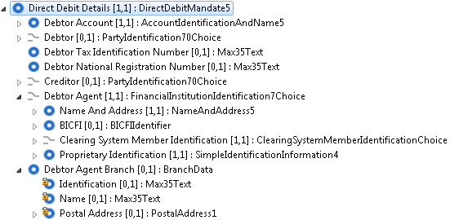
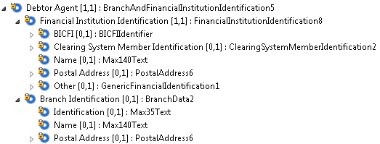
Maintenance Item: CR 27 (UK, 2010)
MXs impacted: sese & acmt, setr
Replace FinancialInstitutionIdentification3Choice
with BranchAndFinancialInstitutionIdentification4
These are now an obsolete MCs
From acmt.006.001.00.06
“The purpose is to take advantage of the inclusive bank account identification method used in the PAIN messages, which enable multiple identifiers to be passed in payment instructions”
From pain.001.001.06
Question: does this mean that Debtor Agent Branch should be removed?
In acmt, etc, only one identifier is allowed (it’s a choice). In the pain MXs, it’s not a choice, several identifiers allowed

